Slide 1
Ease and Safety of Walking in Wind
Team 065
Henry Luo
Janine May
Sean O-Lee
March 12, 2026

Slide 2
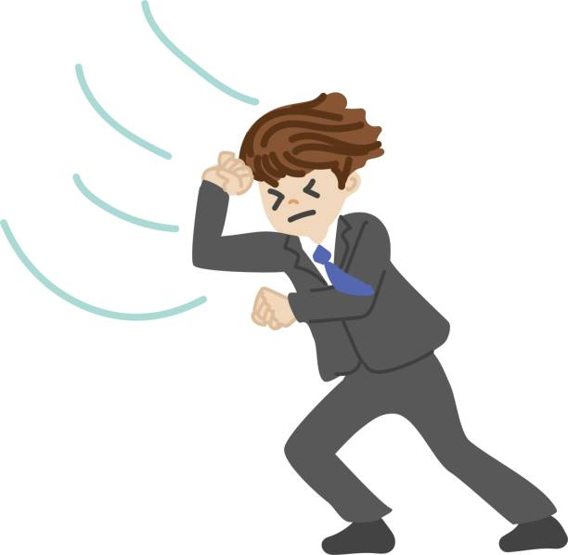
Background & Motivation
Ease and Safety of Walking in Wind
It is a common expectation to travel outside for work, school, or chores in moderate wind speeds. While wind speeds not exceeding 40 mph (30 mph if handling material) are not defined as safety risks by the Occupational Safety and Health Administration (29 C.F.R. § 1926.968), the wind can still make walking outside difficult and potentially unsafe.
The team would like to investigate the optimal angle of hip bend for making walking against a headwind easier by decreasing drag and safer by decreasing lift.

Slide 3
Objectives
Lift and Drag on Bending Hips in Wind
Determine the lift and drag coefficients on a human body at three angles of hip bend using incomplete similarity with a small-scale wind tunnel test
  Approximating a person as a bluff body due to its inherently non-streamlined nature (Leishman, 2023), the drag and lift coefficients become independent from the free stream velocity at sufficiently high Reynolds numbers. These constant coefficients can then be applied with real-life velocities to calculate drag and lift force on a human being.
Draw a conclusion about the ease and safety of walking in different wind speeds at different angles of hip bend

Slide 4
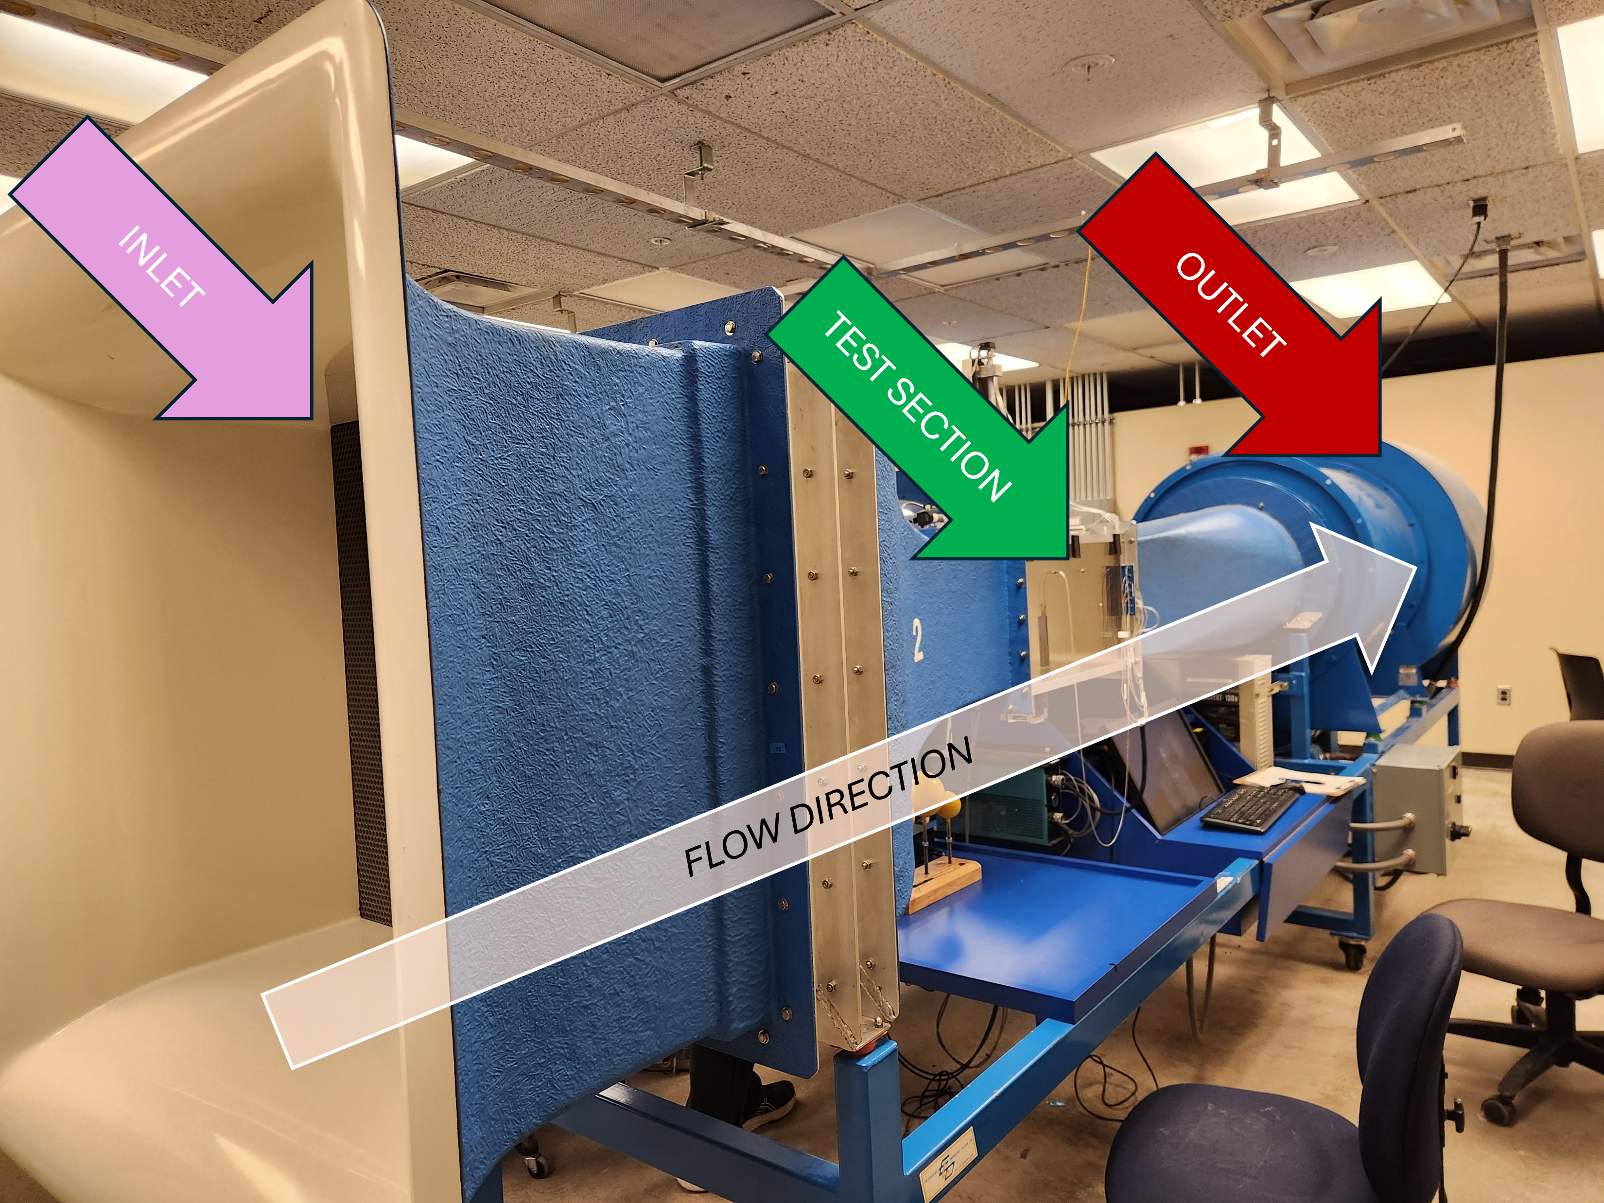
Experiment Facility
Purdue A.A. Potter Engineering Center Wind Tunnel
Test Section Size: 30.5 × 30.5 × 61 cm
Operating Range: 3.0–48.7 m/s
  Driven by 10 HP motor via a 12.40-inch wheel
  Controlled by variable frequency drive (VFD)
Wind tunnel layout.

Slide 5
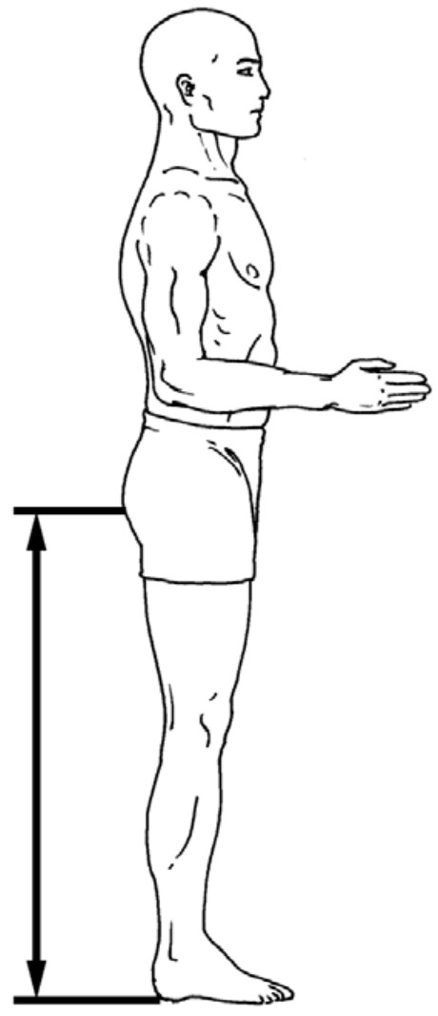
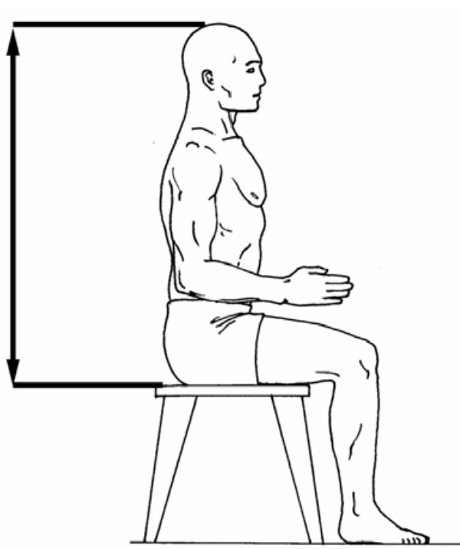
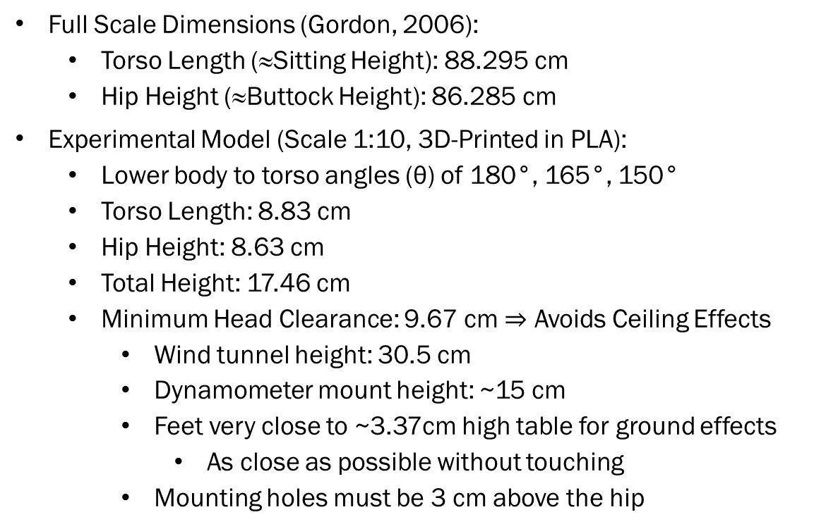
Test Model
Human Model (Scale 1:10)
Full Scale Dimensions (Gordon, 2006):
  Torso Length (≈Sitting Height): 88.295 cm
  Hip Height (≈Buttock Height): 86.285 cm
Experimental Model (Scale 1:10, 3D-Printed in PLA):
  Lower body to torso angles (θ) of 180°, 165°, 150°
  Torso Length: 8.83 cm
  Hip Height: 8.63 cm
  Total Height: 17.46 cm
  Minimum Head Clearance: 9.67 cm $⇒$ Avoids Ceiling Effects
    Wind tunnel height: 30.5 cm
    Dynamometer mount height: ~15 cm
    Feet very close to ~3.37cm high table for ground effects
      As close as possible without touching
    Mounting holes must be 3 cm above the hip
θ
Sitting height (left) and buttock height (right) measurements (Gordon, 2006).

Slide 6
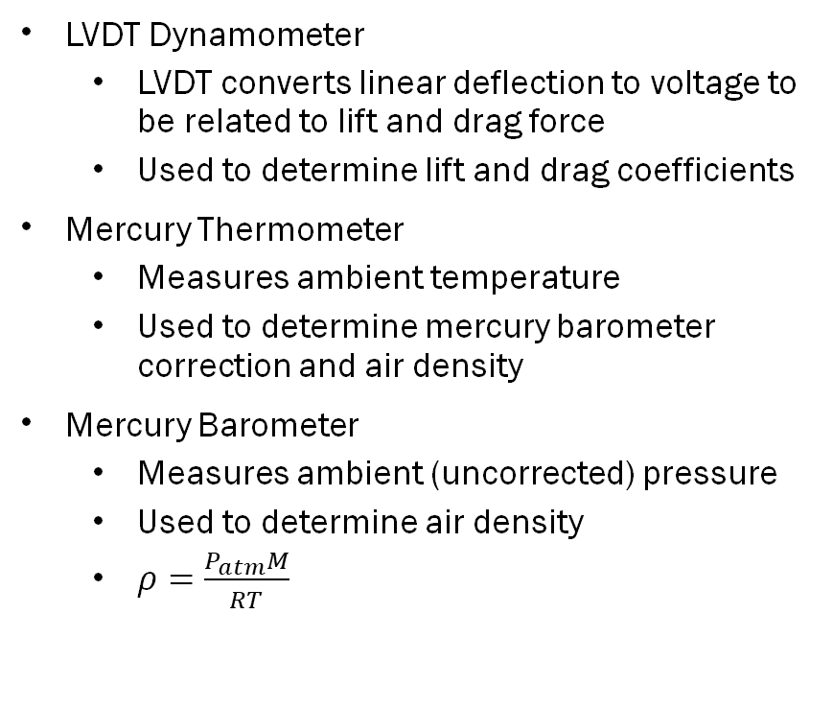

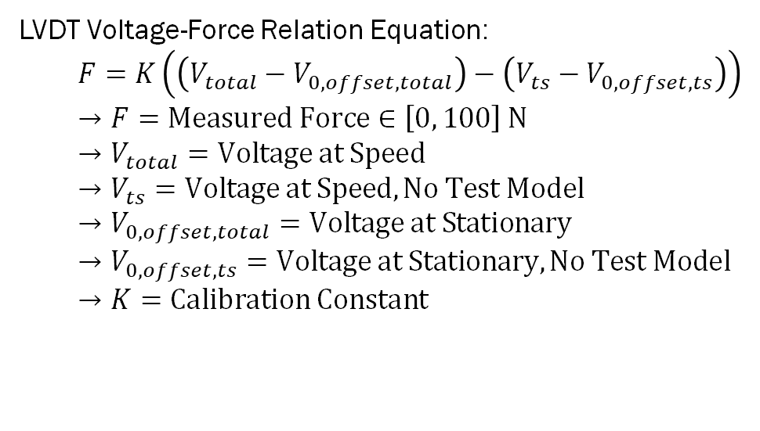
Instrumentation
Dynamometer, Thermometer, & Barometer
LVDT Dynamometer
  LVDT converts linear deflection to voltage to be related to lift and drag force
  Used to determine lift and drag coefficients
Mercury Thermometer
  Measures ambient temperature
  Used to determine mercury barometer correction and air density
Mercury Barometer
  Measures ambient (uncorrected) pressure
  Used to determine air density
  $ρ=\frac{P_{atm}M}{RT}$
LVDT Voltage-Force Relation Equation:
$F=K\left(\left(V_{total}−V_{0,offset,total}\right)−\left(V_{ts}−V_{0,offset,ts}\right)\right)$
$→F=Measured Force∈\left[0, 100\right] N$
$→V_{total}=Voltage at Speed$
$→V_{ts}=Voltage at Speed, No Test Model$
$→V_{0,offset,total}=Voltage at Stationary$
$→V_{0,offset,ts}=Voltage at Stationary, No Test Model$
$→K=Calibration Constant$
Air Density Equation (Ideal Gas Law):
$ρ=\frac{P_{atm}M}{RT}$
$→ρ=Air Density$
$→P_{atm}=Corrected Measured Atmospheric Pressure$
$→M=Molar Mass$
$→R=Universal Gas Constant=8.314 J/(mol⋅K)$
$→T=Measured Ambient Temperature$

Slide 7
Test Plan
Assumptions:
Legs are perfectly normal to and effectively in contact with the ground
Vibrations of the model are negligible
Model in Wind Tunnel
Out of lab:
Create each test model as specified
In Lab:
Measure atmospheric pressure (P_{atm}) and temperature
Using the “Force Measurement Dynamometer” MatLab App used previously, record drag scaling factor and lift scaling factor
With first the empty test section (no model or ground plate), then each model, record voltage data
  After recording data for VFD frequency 0Hz, start at VFD frequency of 30 Hz (22.67 m/s) and increment by 5 HZ until 60 Hz (34.01 m/s) is reached
Process data to determine drag and lift force

Slide 8
Anticipated Results
Numerical Results for Drag and Lift
Data Acquired
  Drag and Lift force on human models of different torso to lower body angle (θ)
Data Processing
  Use voltage readings from the LVDT to calculate the drag and lift forces
  Use forces and free stream velocity to calculate drag and lift coefficients
  Observe that as Reynolds number increases, the drag and lift coefficients become constant at each θ
  Use constant lift and drag coefficients to determine force for true to life scenarios
  Predict unsafe wind speeds using the determined forces

Slide 9
Timeline
3/29
3/30 – 4/4
4/6 – 4/11
4/13 – 4/18
4/13 – 4/18
4/27 – 5/02
Finalize and Submit Proposal
Print Models and Dry Run
Run Tests, Collect Data
Data Processing, Presentation Writing
Presentation, Report Writing
Final Report Submission

Slide 10
References
Gordon, C. C. (2006). Anthropometric Data. https://multisite.eos.ncsu.edu/www-ergocenter-ncsu-edu/wp-content/uploads/sites/18/2016/06/Anthropometric-Detailed-Data-Tables.pdf
Leishman, J. G. (2023a, January 1). Bluff body flows. Introduction to Aerospace Flight Vehicles. https://eaglepubs.erau.edu/introductiontoaerospaceflightvehicles/chapter/bluff-body-flows/
U.S. Department of Labor, Occupational Safety and Health Administration. (n.d.). Electric power transmission and distribution—Mechanical equipment (§ 1926.968). In 29 C.F.R. Part 1926, Subpart V. Electronic Code of Federal Regulations. https://www.ecfr.gov/current/title-29/section-1926.968

Slide 11
Question & Answer

